Slide 1
REGIONAL EXAMINATION
Dr.Nisha
Assistant professor
Dept:of practice of medicine

Slide 2
THYROID GLAND EXAMINATION

Slide 19
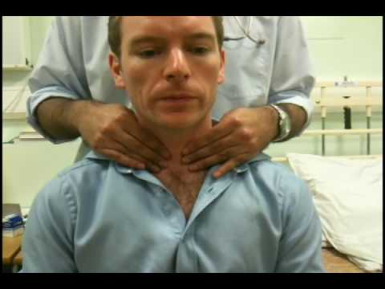

Slide 24
THANK YOU……….

